Slide 1
Bring your CSV import/export configuration of EA to the next level
by using the same configuration for SQL Server automation

Slide 2
Agenda
Why do we need import/export or other approaches of data interchange in EA?
Built In
CSV Import/Export
XMI + Reference Data
Native Format (Database Dump)
Data Mining
Pro Cloud Server Integrations
Prolaborate Integrations
Automation
EA API
Pro Cloud Server OSLC/RDF, SBPI
Database Approaches
Live is Life

Slide 3
Why
Collaboration and Stakeholder Engagement
Integration with Other Tools
Data Migration and Legacy System Integration
Standardization and Compliance
Cross-Platform Collaboration
Automated Model Generation
Interoperability in Enterprise Architecture Frameworks
Notes:
1. Collaboration and Stakeholder Engagement
EA is often used by teams spread across different departments or even organizations. Import/export mechanisms allow these teams to share models and diagrams efficiently.
Different stakeholders may require specific views or sections of the model. Exporting data in formats like XMI (XML Metadata Interchange) allows teams to exchange models between different instances of EA or with other modeling tools, promoting collaboration.
2. Integration with Other Tools
Many organizations use a variety of software tools for requirements management, version control, testing, and project management. EA supports integration with these tools through data interchange.
Importing and exporting data in standardized formats (e.g., CSV, XML, BPMN) allows seamless integration with tools like IBM Rational DOORS, Jira, or custom databases.
3. Data Migration and Legacy System Integration
When transitioning from older systems or tools to EA, importing legacy data ensures that existing information is preserved and used within the new environment.
Exporting EA data may also be required when systems are phased out or migrated to other environments.
4. Version Control and Backup
Exporting models is an effective way to create backups or maintain different versions of the model in a readable and structured format.
Version-controlled repositories often rely on exporting models to track changes and revisions over time.
5. Standardization and Compliance
In many industries (e.g., aerospace, automotive, defense), models must adhere to specific standards like UML, SysML, or BPMN. EA’s export/import functionality ensures that models can be interchanged and validated against these standards.
By using formats like XMI, EA ensures compatibility with external frameworks and supports interoperability within a standards-based ecosystem.
6. Cross-Platform Collaboration
Not all team members may use EA exclusively. Data interchange allows models to be shared with teams using other modeling tools (e.g., MagicDraw, IBM Rational).
Import/export makes it easier to collaborate with third-party consultants or organizations using different tools but still need access to EA models.
7. Automated Model Generation
Some organizations have automated processes to generate or modify models based on real-time data. Importing that data into EA allows for automated model generation and synchronization with external systems.
Similarly, models developed in EA can be exported to drive external processes or visualizations.
8. Interoperability in Enterprise Architecture Frameworks
In frameworks like TOGAF or NAFv4 (which you work with), interoperability across different EA tools and repositories is crucial. EA’s ability to export/import data facilitates architecture alignment and consistency across frameworks.
In short, import/export and data interchange mechanisms in Sparx Enterprise Architect enhance its flexibility, ensuring the tool can adapt to the evolving needs of the enterprise, integrate with existing tools, and support collaborative work environments across various platforms.

Slide 4
Sparx Enterprise Architect - Part 1
Enterprise Architect – Built In
XMI 2.5 Diagram Interchange
Customizable CSV incl. hierachy (nesting) and TaggedValues (and nothing more)
Publishing/Export
Ecore, Arcgis, BPMN 2.0 XML, XPDL, OWL/RDF [Web Ontology], Normative XMI
Import
MDZIP [Magic Draw] incl. diagrams, EMF [Eclipse Meta Format], UML2, Rhapsody, BPMN 2.0 XML, DMN 1.1, OWL/RDF
MDG for Office
Templates for Excel (includes full structure), Word Import und Export und Powerpoint Export
Native Format (for Import, Export incl. complete project model and project reference data) (Database Dump)
DataMiner for JSON, XLSX, ODBC, HTML using Scripting (includes full structure)

Slide 5
Sparx Enterprise Architect – Part 2
Custom Solutions
Add-In Development
Scripting
3rd Parties implementing integrations from/to EA based on EA API

Slide 6
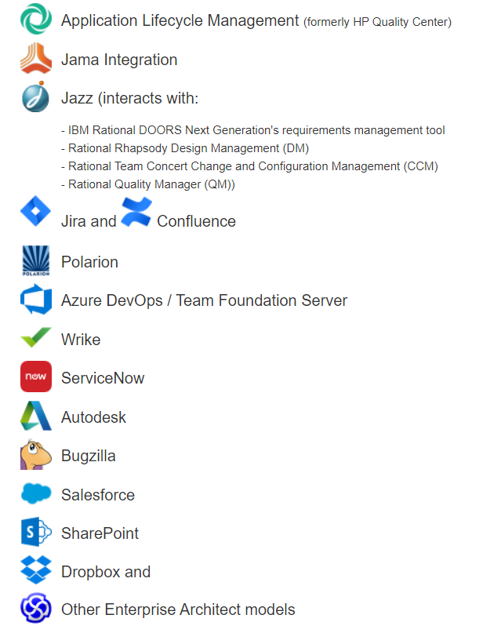
Sparx ProCloud Server (PCS) – Part 1
Pre Built Integrations
Here we plan to have a lot more for the future

Slide 7
Sparx ProCloud Server – Part 2
Custom Solutions
Using PCS OSLC/RDF (Open Services for Lifecycle) (RESTful API with RDF (Ressource Description Framework))
For free edition limited to Requirements only
SBPI (Server Base Plugin Interface)
For custom integrations
For custom services
3rd Parties implementing integrations from/to ProCloud Server based on OSLC/RDF and/or SBPI

Slide 8
Sparx Prolaborate (Prolaborate)
Publish
Confluence
Sharepoint
Teams
Integration
Jira
Azure DevOps

Slide 9
Why should we use SQL Server for performing CSV import/export
Sparx Enterprise Architect has a very stable (since version 4 not real need for changing the underlying database structure)
ProCloud Server brings database scripts for the relevant 20 tables to make use of row level security capabilities of Oracle/MS SQL server and allows a deep dive into the structure
Thomas Kilian wrote a book how to query EA Database Repositories ☺ (Inside Enterprise… by Thomas Kilian [Leanpub PDF/iPad/Kindle])

Slide 10
What are the steps
Create a new database
Create EA Schema
Update EA Schema (it is optional, but I do recommend)
Create EA Base Structure
Create CSV Logfile Structure
Create CSV Routines
Open EA Repo
Create a view where to import
1.000
100.000
Import Reference Data (CSV Import/Export Specification)
EA Way
Import 1.000 records in EA
Wait 2min
SQL Server Way
Import a Flat File with 100.000 records into SQL Server
Execute Procedure
Wait 2min
See what happend in EA

Slide 11

Live is Life

